Slide 1
Εξαιρέσεις
Exceptions

Slide 2
Types of Exception in Java
In Java, exception is an event that occurs during the execution of a program and disrupts the normal flow of the program's instructions. Bugs or errors that we don't want and restrict our program's normal execution of code are referred to as exceptions.
Exceptions can be categorized into two ways:
Built-in Exceptions
Checked Exception
Unchecked Exception
User-Defined Exceptions

Slide 3
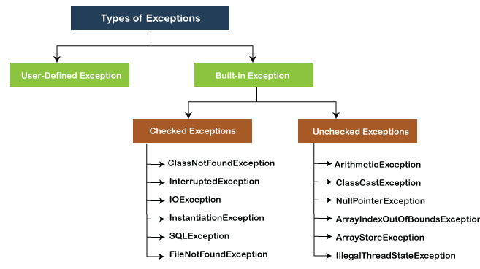

Slide 4
Built-in Exceptions
Exceptions that are already available in Java libraries are referred to as built-in exception. These exceptions are able to define the error situation so that we can understand the reason of getting this error.
It can be categorized into two broad categories, i.e., checked exceptions and unchecked exception.
Checked Exception
Checked exceptions are called compile-time exceptions because these exceptions are checked at compile-time by the compiler. The compiler ensures whether the programmer handles the exception or not. The programmer should have to handle the exception; otherwise, the system has shown a compilation error.
Βλ. Checked1.java

Slide 5
How to resolve the error?
There are basically two ways through which we can solve these errors.
The exceptions occur in the main method.
We can get rid from these compilation errors by declaring the exception in the main method using the throws.
We only declare the IOException, not FileNotFoundException, because of the child-parent relationship. The IOException class is the parent class of FileNotFoundException, so this exception will automatically cover by IOException. We will declare the exception in the following way:
class Exception{
public static void main(String args[]) throws IOException {
...

Slide 6
…
2) We can also handle these exception using try-catch
public static void main(String args[]) {
FileInputStream file_data = null;
try {
file_data = new FileInputStream("Hello.txt");
} catch(FileNotFoundException fnfe){
System.out.println("File Not Found!");
}

Slide 7
Unchecked Exceptions
The unchecked exceptions are just opposite to the checked exceptions. The compiler will not check these exceptions at compile time. In simple words, if a program throws an unchecked exception, and even if we didn't handle or declare it, the program would not give a compilation error.
Usually, it occurs when the user provides bad data during the interaction with the program.

Slide 8
…
1) int postive = 35;
int zero = 0;
int result = positive/zero;
2) int num[] ={10,20,30,40,50,60};
System.out.println(num[7]);

Slide 9
User-defined Exception
In Java, we already have some built-in exception classes like ArrayIndexOutOfBoundsException, NullPointerException, and ArithmeticException. These exceptions are restricted to trigger on some predefined conditions.
In Java, we can write our own exception class by extends the Exception class.
We can throw our own exception on a particular condition using the throw keyword, using the
try-catch block and
throw keyword.

Slide 10
UserDefinedException.java
class UserDefinedException {
public static void main(String args[]){
try {
throw new NewException(5);
}
catch(NewException ex){
System.out.println(ex) ;
}
}
}
class NewException extends Exception{
int x;
NewException(int y) {
x=y;
}
public String toString(){
return ("Exception value = "+x) ;
}
}

